Slide 1
Discrete Structures
Lecture 5

Slide 2
Exercise
An interesting teacher keeps me awake.
I stay awake in Discrete Mathematics class.
Therefore, my Discrete Mathematics teacher is interesting.
Is the above argument valid?

Slide 3
ARGUMENT
An argument is a list of statements called premises (or assumptions or hypotheses) followed by a statement called the conclusion.

Slide 4
ARGUMENT
P1 Premise
P2 Premise
P3 Premise
. . . . .. . . . .
Pn Premise
______________
∴C Conclusion

Slide 5
VALID ARGUMENT
An argument is valid if the conclusion is true when all the premises are true.
Alternatively, an argument is valid if conjunction of its premises imply conclusion.
That is (P1∧ P2 ∧ P3 ∧ . . . ∧ Pn) → C is a tautology.

Slide 6
INVALID ARGUMENT
An argument is invalid if the conclusion is false when all the premises are true.
Alternatively, an argument is invalid if conjunction of its premises does not imply conclusion.

Slide 7
EXAMPLE
Show that the following argument form is valid:
p→q premise
p premise
∴ q conclusion

Slide 8
EXAMPLE
p | q | p→q | p | q
T | T | T | T | T
T | F | F | T | F
F | T | T | F | T
F | F | T | F | F

Slide 9
EXAMPLE
Show that the following argument form is valid:
p→q premise
q premise
∴ p conclusion

Slide 10
EXAMPLE
p | q | p→q | q | p
T | T | T | T | T
T | F | F | F | T
F | T | T | T | F
F | F | T | F | F

Slide 11
EXAMPLE
Use truth table to determine the argument form
p ∨ q
p → ~q
p → r
∴ r
is valid or invalid.

Slide 12
EXAMPLE
p | q | r | p∨q | p→~q | p→r | r
T | T | T | T | F | T | T
T | T | F | T | F | F | F
T | F | T | T | T | T | T
T | F | F | T | T | F | F
F | T | T | T | T | T | T
F | T | F | T | T | T | F
F | F | T | F | T | T | T
F | F | F | F | T | T | F

Slide 13
EXAMPLE
If Tariq is not in team A, then Hameed is in team B.
If Hameed is not in team B, then Tariq is in team A.
Tariq is not in team A or Hameed is not in team B.
Let
t = Tariq is in team A
h = Hameed is in team B
Then the argument is
~ t → h
~ h → t
∴ ~ t ∨ ~ h

Slide 14
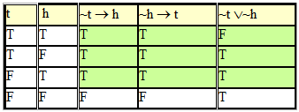
EXAMPLE

Slide 15
EXAMPLE
If at least one of these two numbers is divisible by 6, then the product of these two numbers is divisible by 6.
Neither of these two numbers is divisible by 6.
The product of these two numbers is not divisible by 6.

Slide 16
EXAMPLE
If at least one of these two numbers is divisible by 6, then the product of these two numbers is divisible by 6.
Neither of these two numbers is divisible by 6.
The product of these two numbers is not divisible by 6.
Let
d = at least one of these two numbers is divisible by 6.
p = product of these two numbers is divisible by 6.
Then the argument become in these symbols
d → p
~ d
∴ ~ p

Slide 17
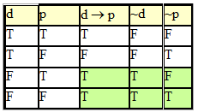
EXAMPLE

Slide 18
EXAMPLE
If I get an Eid bonus, I’ll buy a stereo.
If I sell my motorcycle, I’ll buy a stereo.
  ∴ If I get an Eid bonus or I sell my motorcycle, then I’ll buy a stereo.

Slide 19
EXAMPLE
If I get an Eid bonus, I’ll buy a stereo.
If I sell my motorcycle, I’ll buy a stereo.
  ∴ If I get an Eid bonus or I sell my motorcycle, then I’ll buy a stereo.
SOLUTION:
Let
e = I get an Eid bonus
s = I’ll buy a stereo
m = I sell my motorcycle
The argument is
e → s
m → s
∴e ∨ m → s

Slide 20
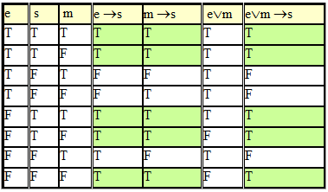
EXAMPLE

Slide 21
EXERCISE
An interesting teacher keeps me awake. I stay awake in Discrete Mathematics class. Therefore, my Discrete Mathematics teacher is interesting.

